Slide 1
Final Year Project Markson’s Memory
Conor Kelleher
13395381
Supervisor: Mark Keane

Slide 2

Distant Reading How and why?

Slide 3
Finding Entities
“There was Cezanne, of course.
Although it was not Cezanne but was Renoir.”

Slide 4
Finding Entities
“There was Cezanne, of course.
Although it was not Cezanne but was Renoir.”

Slide 5
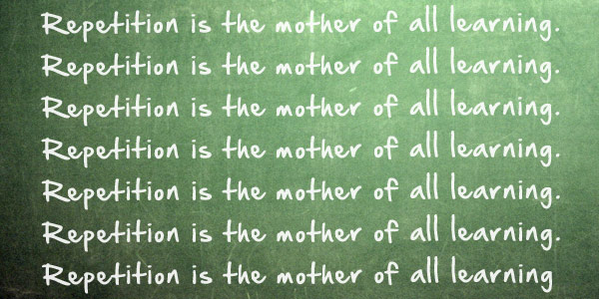

Slide 6
“Any idea, plan, or purpose may be placed in the
mind through repetition of thought.”
– Napoleon Hill

Slide 7
Same-paragraph mentions

Slide 8

Same-paragraph mentions

Slide 9
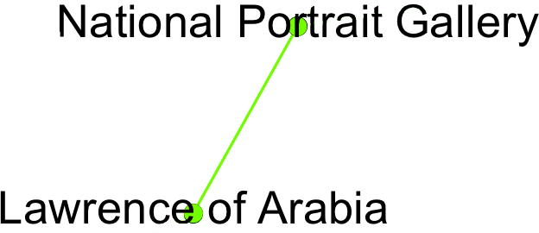
Same-paragraph mentions

Slide 10
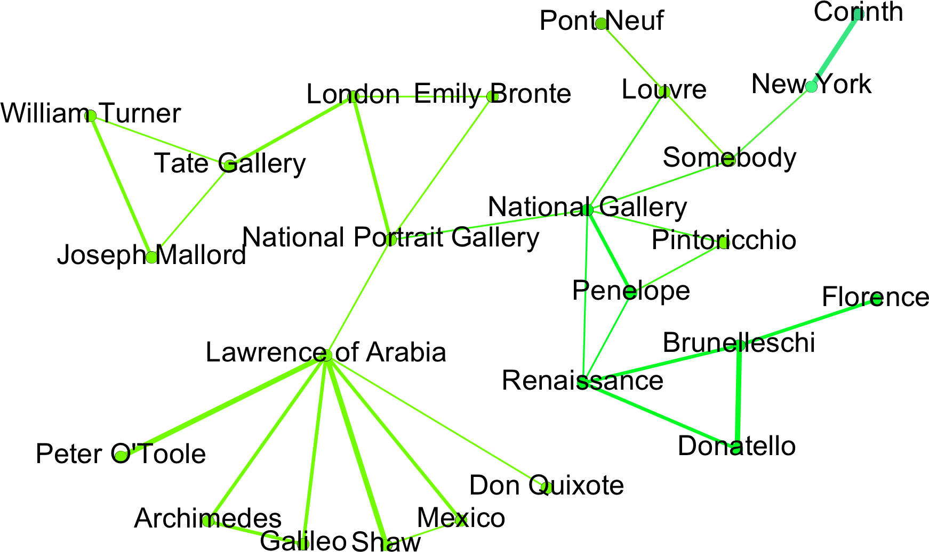
Same-paragraph mentions

Slide 11
Same-paragraph mentions

Slide 12
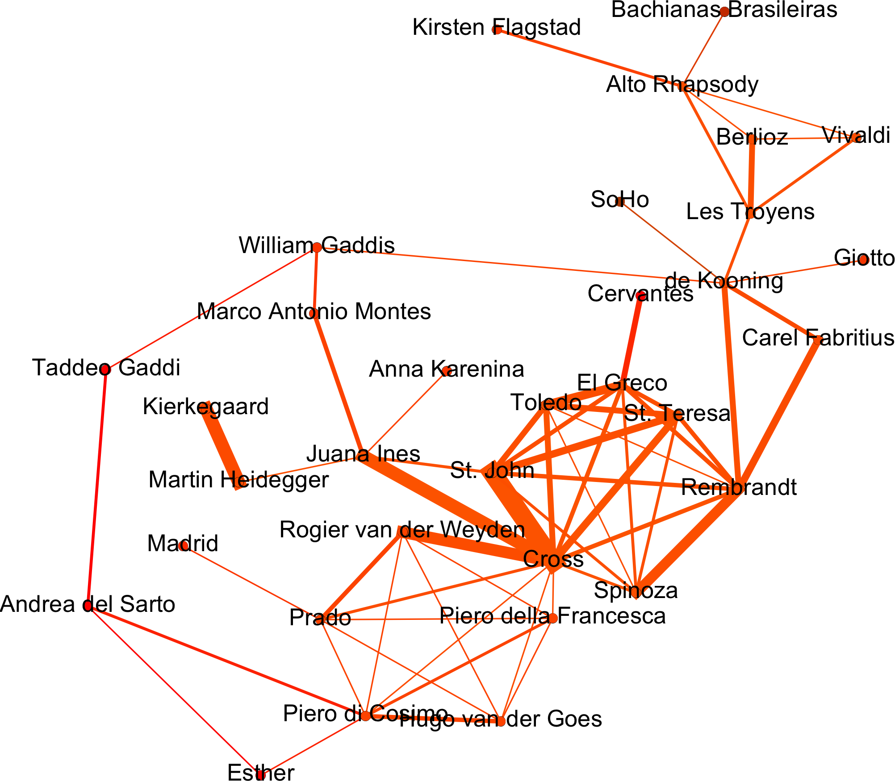
Same-paragraph mentions

Slide 13
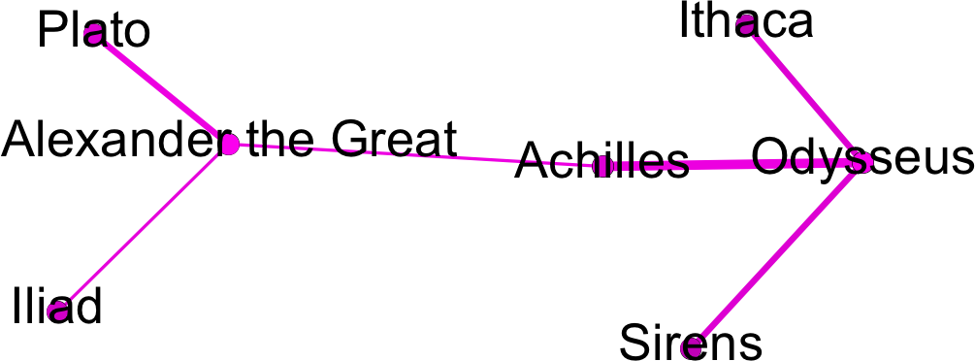
Same-paragraph mentions

Slide 14
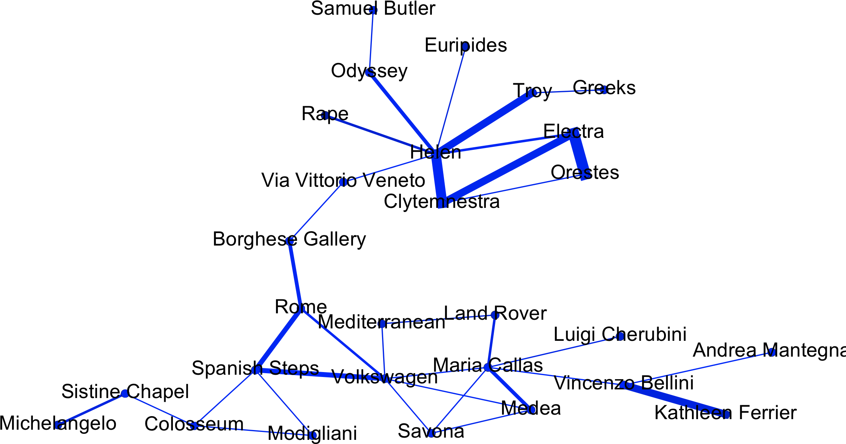
Same-paragraph mentions

Slide 15
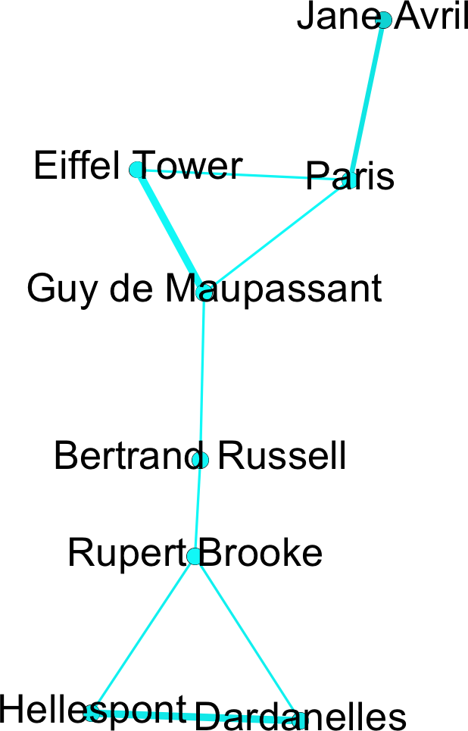
Same-paragraph mentions

Slide 16
One paragraph further…

Slide 17
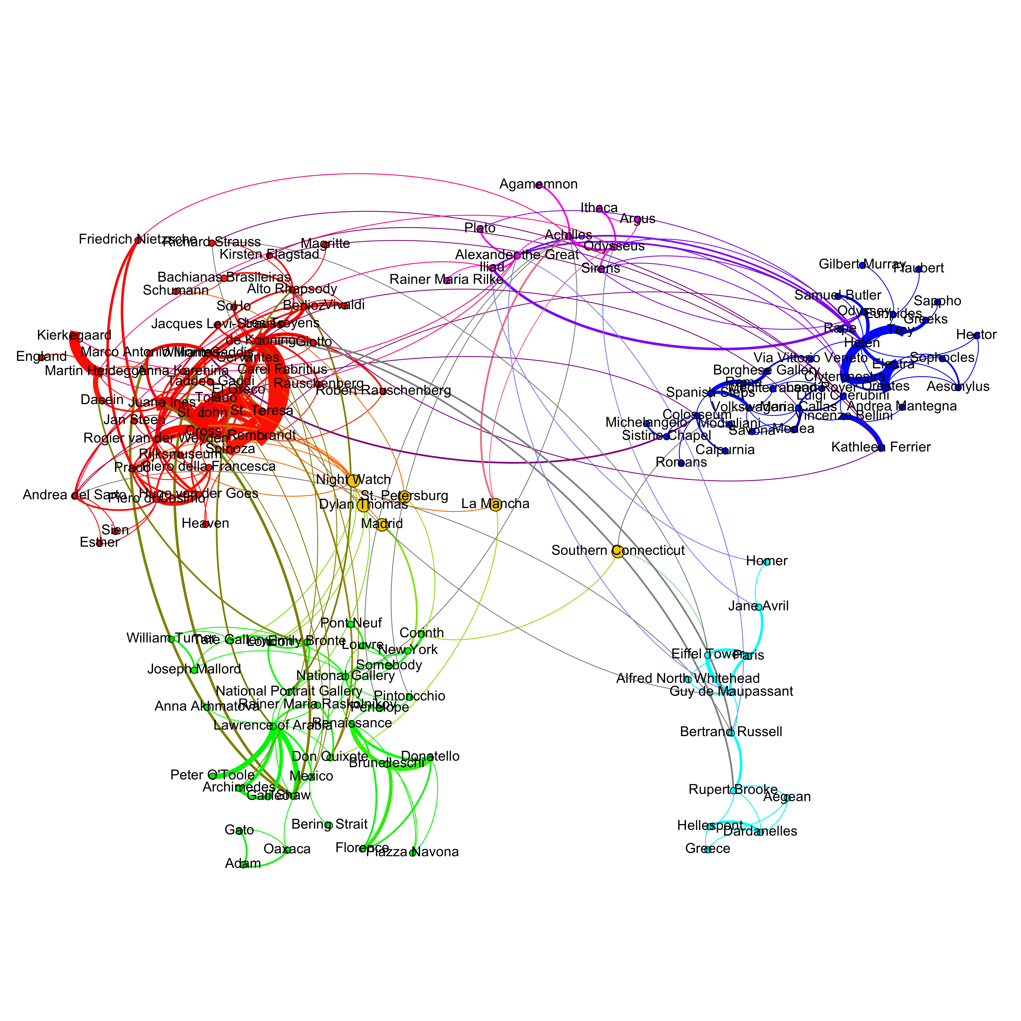
One paragraph further…

Slide 18
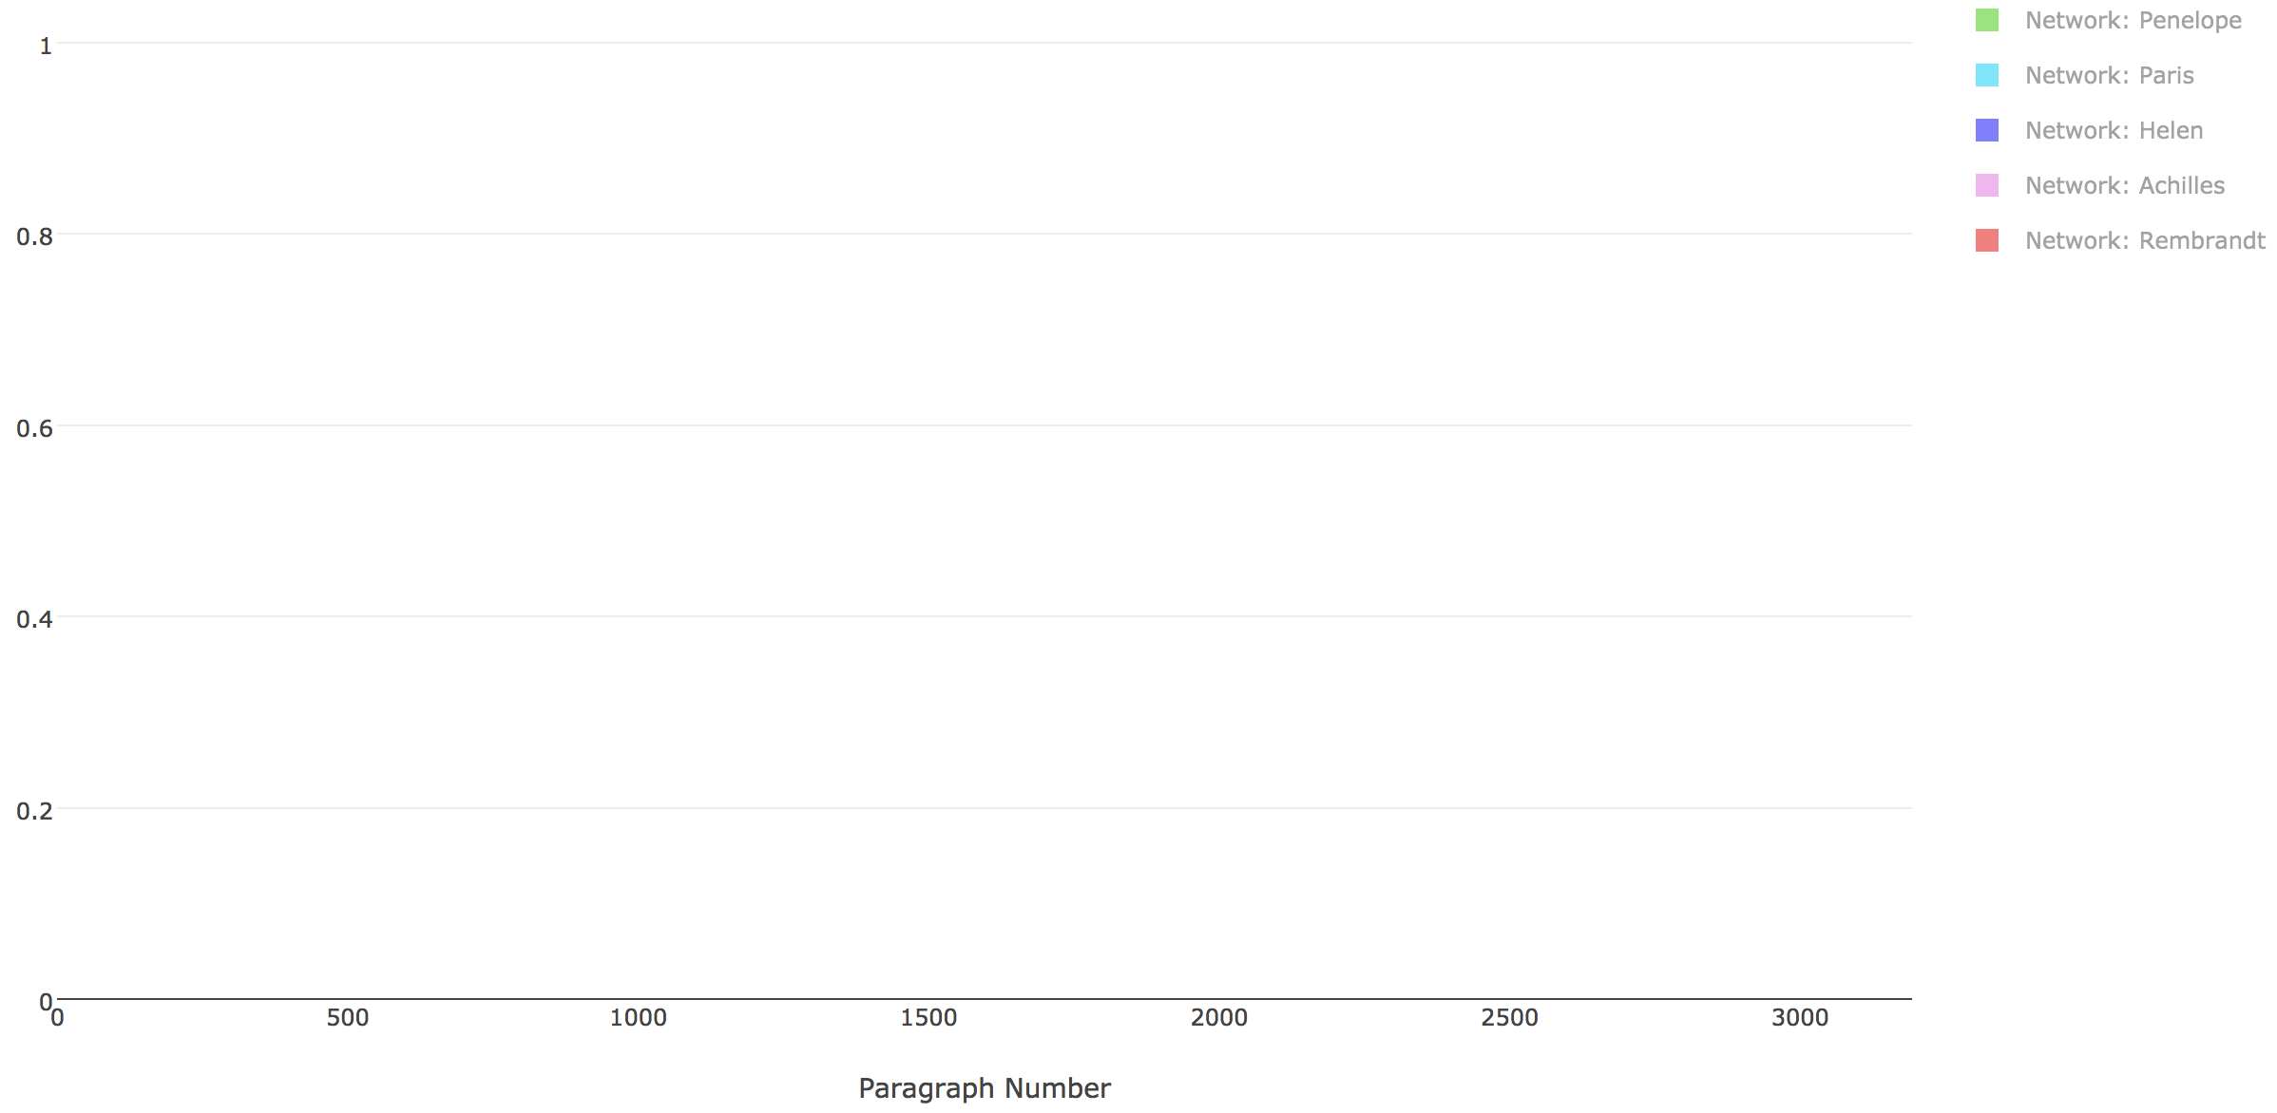
Adding a Timeline

Slide 19
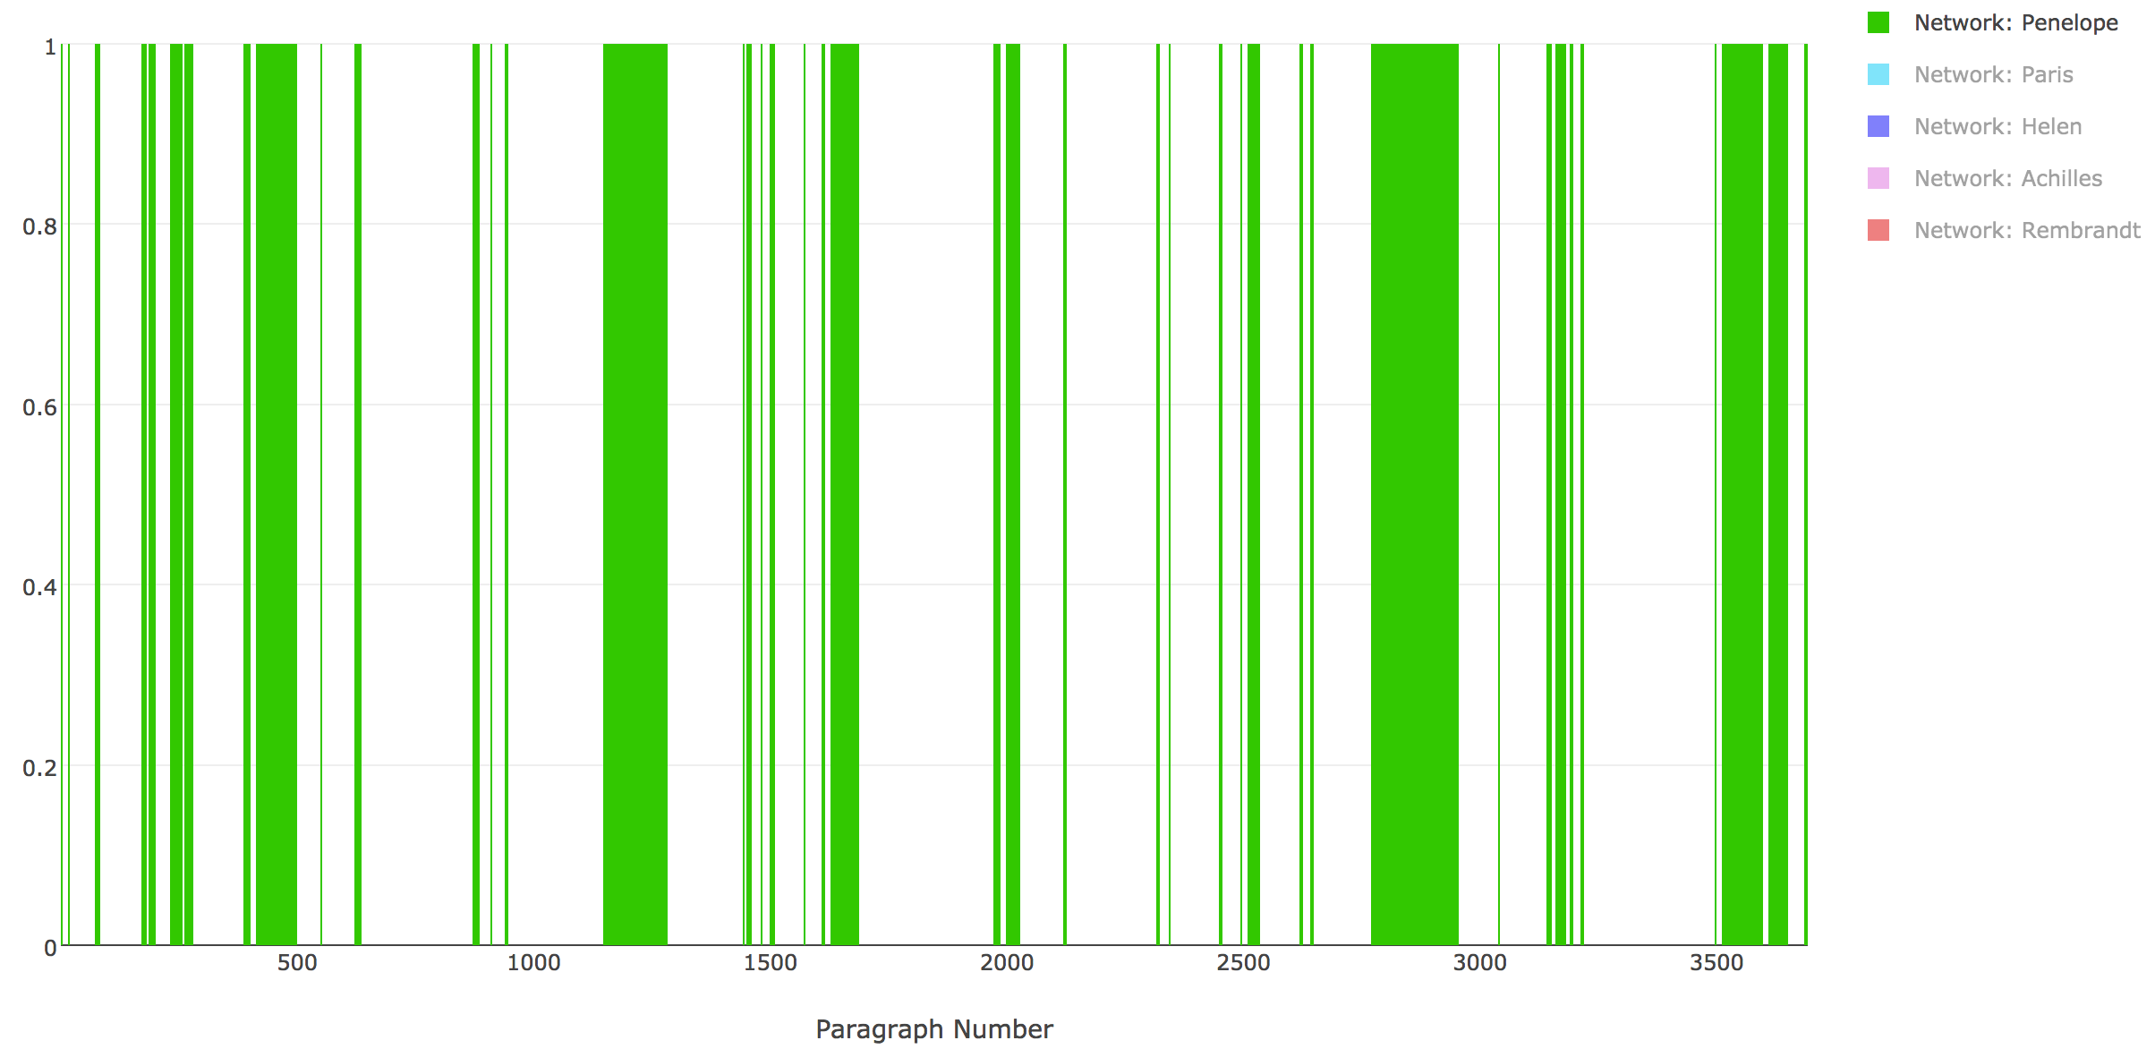
Adding a Timeline

Slide 20
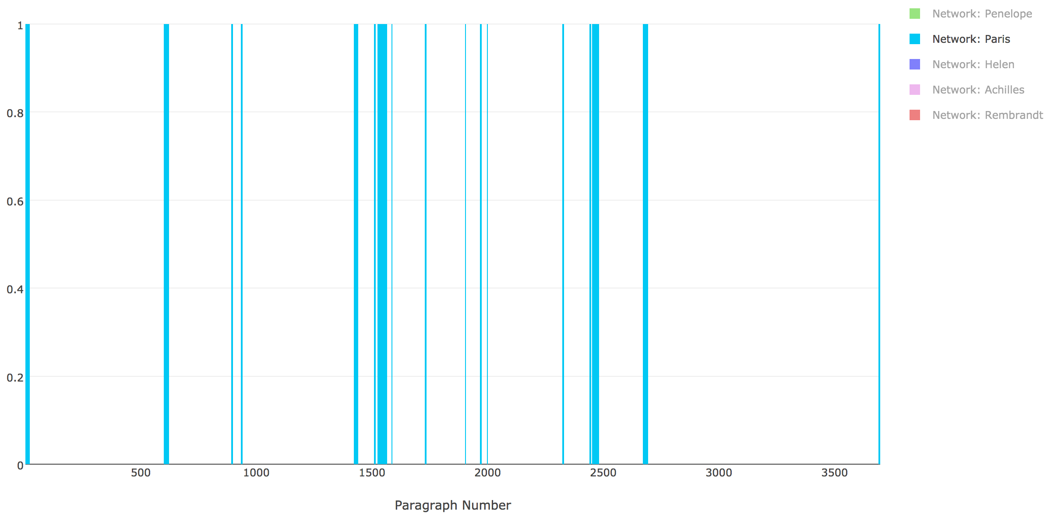
Adding a Timeline

Slide 21
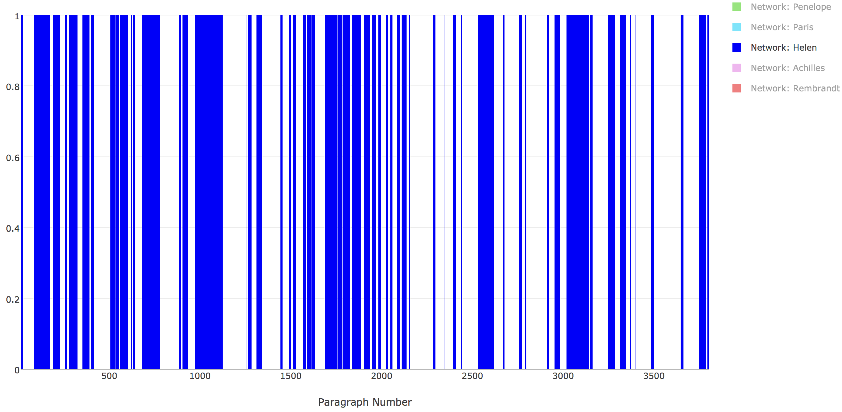
Adding a Timeline

Slide 22
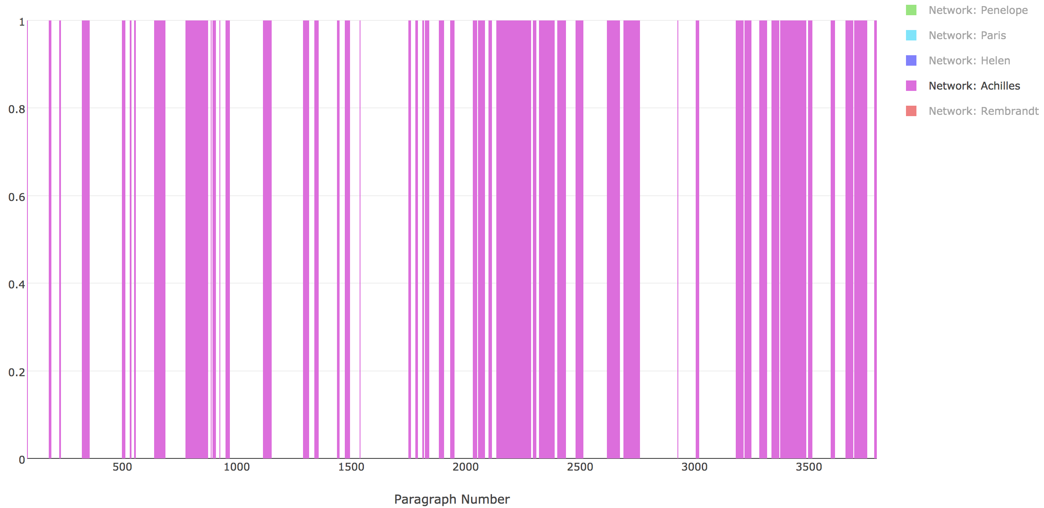
Adding a Timeline

Slide 23
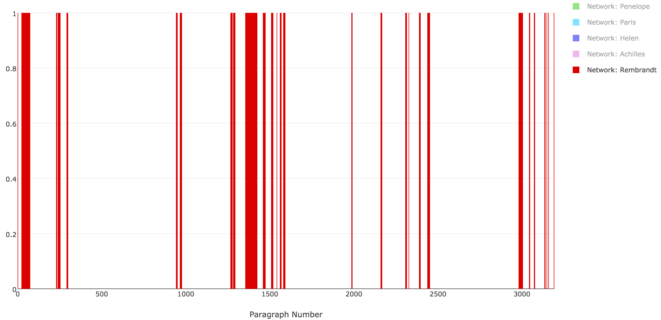
Adding a Timeline

Slide 24
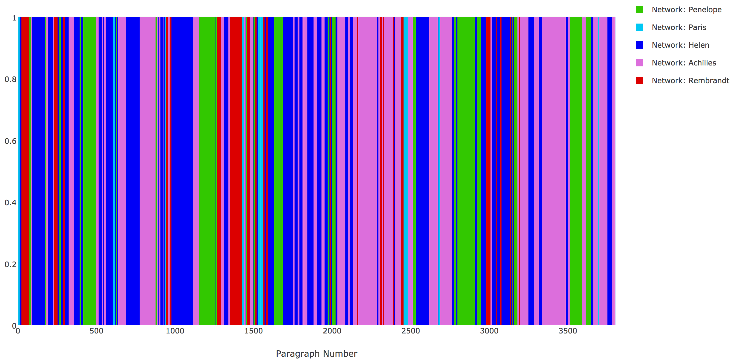
Adding a Timeline

Slide 25
Adding a Timeline
What to make of this?

Slide 26
Following the train of thought

Slide 27

Following the train of thought
Concept A

Slide 28

Following the train of thought
Concept A
Concept B

Slide 29
Following the train of thought
Concept A
Concept B
Concept C

Slide 30
Following the train of thought
Concept A
Concept B
Concept C
Repetition?...

Slide 31
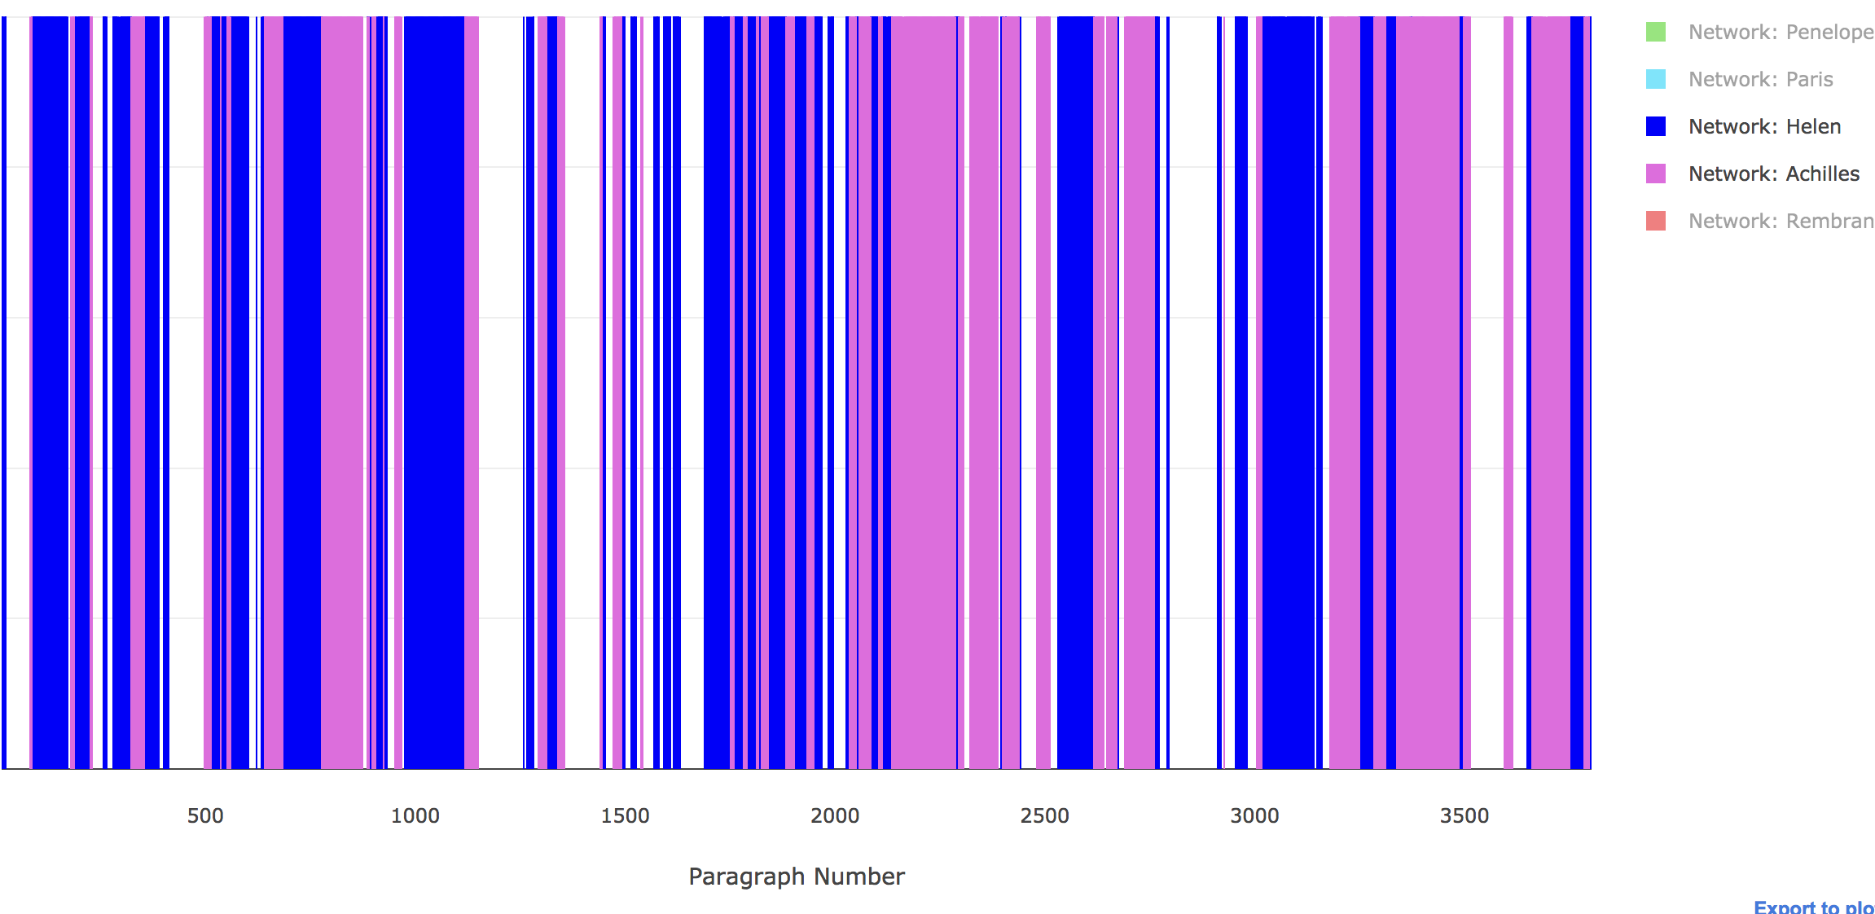
Network:
Helen
Network:
Achilles

Slide 32
Conclusions
Named Entity Recognition
Repeated Phrases
Both giving us…
Entity Social Network
Co-occurrence timeline
Deep regularities in
The words used (Exact phrase matches)
Associative structure (Context and thought in the narrative)

Slide 33
Questions?
conor.kelleher.1@ucdconnect.ie
Conor Kelleher
BSc. Computer Science

